Slide 1
Optimizing Generative Inference
Daniel Gorelik (djgoreli), Norman Wen (normanqw), Zhixiang Teoh (zhteoh)

Slide 2
Orca: A Distributed Serving System for
Transformer-Based Generative Models*
Gyeong-In Yu, Joo Seong Jeong, Geon-Woo Kim, Soojeong Kim, Byung-Gon Chun
*OSDI 2022
Notes:
We are going to start with a brief overview of the Orca paper, to provide context behind LLM Inference serving systems, and some of their earlier optimizations

Slide 3
Motivation: Serving LLMs is very expensive and can be slow
1 NVIDIA A100 GPU can process < 1 requests / second even on moderate-sized LLMs (LLaMa-13B)
Many GPUs are required to provide inference on production-scale LLM services
However, serving instances of large models like GPT3 / GPT4 can approach costs of $1 million / year
Goal: Improve throughput of serving transformer-based generative models in order to reduce cost
Notes:
Q: What about latency? A: Focus is on throughput because throughput is what reduces cost. There are features incorporated that help both latency and throughput, but they stay away from latency optimizations at the expense of throughput.

Slide 4
Transformer inference recap: token generation
Iteration 1
Iteration 2
Iteration 3
is
great
<eos>
Layer 3
Layer 3
Layer 3
Layer 2
Layer 2
Layer 2
Layer 1
Layer 1
Layer 1
I
think
this
is
great
Notes:
Generate one token at a time
In the first iteration, process all input tokens at once
In future iterations, the singular token generated in the previous iteration is the input
Use attention keys & values of all previous tokens to compute next token
This repeats until EOS token or max token length

Slide 5
Serving a generative language model
Inference Server
Execution Engine
(E.g. Triton Inference Server, TenserFlow Serving, TorchServe)
(E.g. Megatron-LM, TensorFlow, PyTorch)
requests
Model
Scheduler
Layer 3
Layer 2
responses
x₁: I think
x₂: I love
Layer 1
Request Queue
*max batch size = 3
Notes:
The main component of the serving system is the scheduler, which is responsible for creating a batch of requests by retrieving requests from a queue and scheduling the execution engine to process the batch.
Here we see two requests: 1 “I think” and 2 “I love”. The scheduler makes a batch of size 2 and sends these requests to the execution engine, which contains the model.

Slide 6

Serving a generative language model
Inference Server
Execution Engine
(E.g. Triton Inference Server, TenserFlow Serving, TorchServe)
(E.g. Megatron-LM, TensorFlow, PyTorch)
requests
Model
Scheduler
Layer 3
xₗ: I think
Layer 2
responses
x₂: I love
Layer 1
Request Queue
*max batch size = 3
Notes:
The execution engine processes the received batch by running multiple iterations of the model being served and returns the generated text back to the serving system.

Slide 7
Serving a generative language model
Inference Server
Execution Engine
(E.g. Triton Inference Server, TenserFlow Serving, TorchServe)
(E.g. Megatron-LM, TensorFlow, PyTorch)
requests
Model
Scheduler
Layer 3
Layer 2
responses
Layer 1
x₁: this is great
Request Queue
x₂: you
*max batch size = 3
Notes:
After the execution engine processes both requests completely, it returns back the responses: “this is great” and “you” for requests “I think” and “I love”, respectively.

Slide 8
Orca: scheduling requests
Problem 1: request-level scheduling
The execution engine must wait for all requests in the batch to finish before processing any new requests -> increases latency
When a new request arrives in the middle of an execution, it must wait until the current batch is completely processed even if the batch is not full -> increases latency
Solution 1: iteration-level scheduling
Schedule the system per-iteration instead of per-request!
If one request finishes in batch, return it to the client before others are completed
If a new request arrives and there is space in the batch, schedule it next iteration
Notes:
Some of the problems with this general system are seen with early finishing requests and late arriving requests
*Go back a few slides to illustrate this problem*
To define iteration, I mean one iteration of token generation

Slide 9
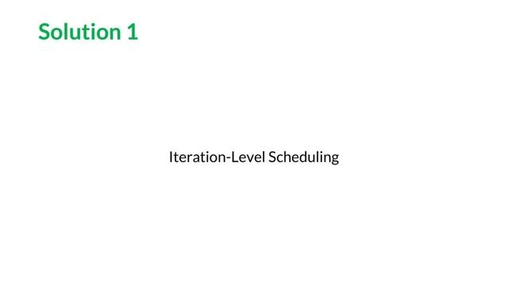
PeriFlow: How to Serve Large-scale Transformer Models - FriendliAI Tech & Research, Jul 2022
Notes:
We see our same two requests here
Suddenly a third request of “A man” appears
Because we are operating on a per-iteration basis, the execution engine only processes the next token of our started requests rescheduling them back in the request pool and re-batching them with the new request
The execution engine now processes one iteration of these three requests, when two more appear
Again the next iteration of the batch is processed, “I love you” is completed, and we schedule again per-iteration

Slide 10

PeriFlow: How to Serve Large-scale Transformer Models - FriendliAI Tech & Research, Jul 2022
Notes:
We see our same two requests here
Suddenly a third request of “A man” appears
Because we are operating on an iteration basis, the execution engine only processes the next token of our started requests rescheduling them back in the request pool and re-batching them with the new request
The execution engine now processes one iteration of these three requests, when two more appear
Again the next iteration of the batch is processed, “I love you” is completed, and we schedule again per-iteration

Slide 11
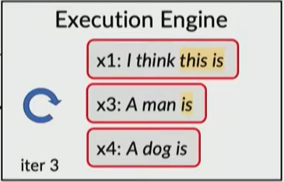
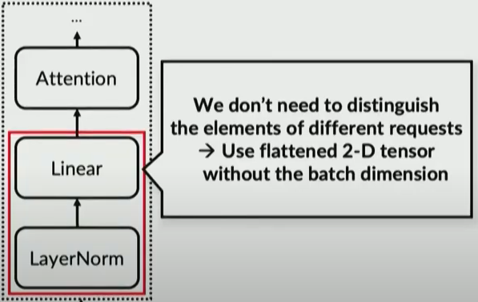
Orca: batching
Problem 2: how to batch with iteration-level scheduling?
Batching is only applicable when:
Requests are in the same phase (initiation vs. increment)
Requests have the same length
Attention op cannot be batched as tensors are not the same shape
Solution 2: selective batching
Apply batching to non-attention ops together
For attention op, split batch by request and apply token-wise
Transformer
Notes:
For computational efficiency, it is a must that the engine is able to process any selected set of requests in a batched manner
We see in the image to the right, that the requests are not in the same phase (x1 and x3 are incrementing, x4 is initiating)
In addition, x1 and x3 have length 1 as input while x4 has length 3
Attention operation requires a notion of requests (i.e., requires a batch dimension) to compute attention only between the tokens of the same request.
Their findings show that the decision not to batch the executions of the Attention operation has only a small impact on efficiency
Problem 2: How to batch with iteration-level scheduling?
Solution 2: Selective Batching

Slide 12
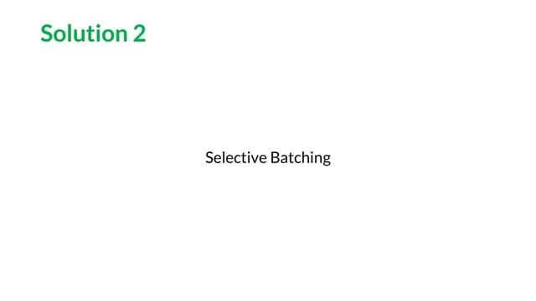
PeriFlow: How to Serve Large-scale Transformer Models - FriendliAI Tech & Research, Jul 2022
Notes:
The first and last operators are non-attention, so we can keep the batch together and flatten irrespective of the requests that tokens come from
Once we get to the attention operator, the requests that tokens come from do matter, so we split back up and compute this separately.
We get the individual outputs, which we merge back together and batch once again for the last non-attention operator.

Slide 13
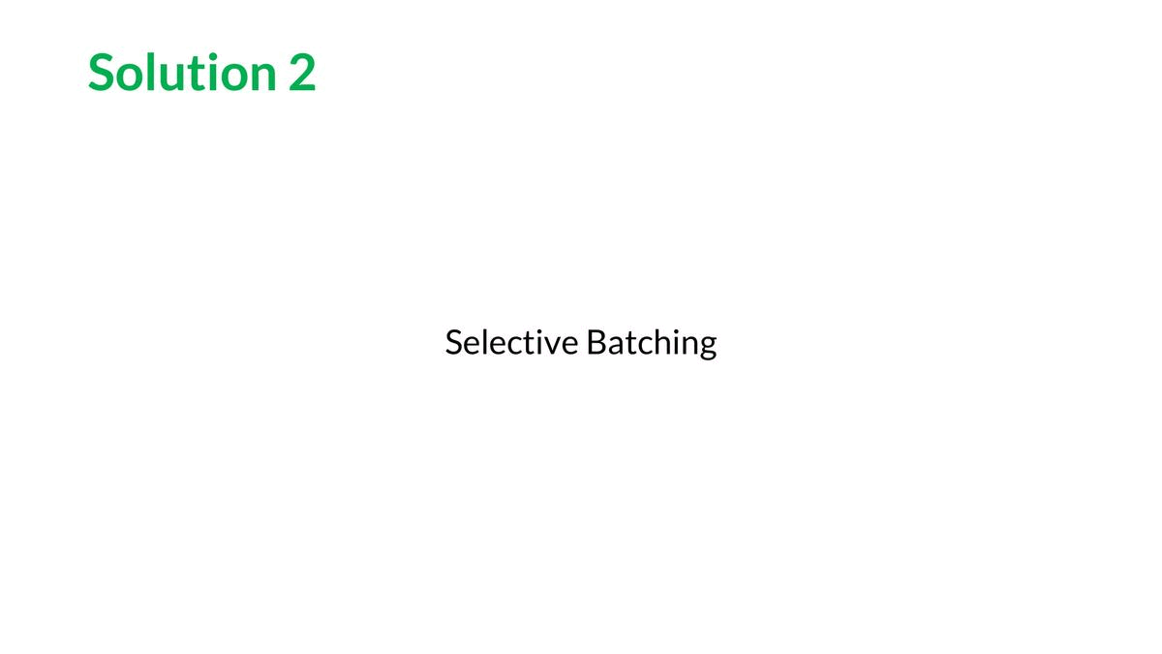
PeriFlow: How to Serve Large-scale Transformer Models - FriendliAI Tech & Research, Jul 2022

Slide 14
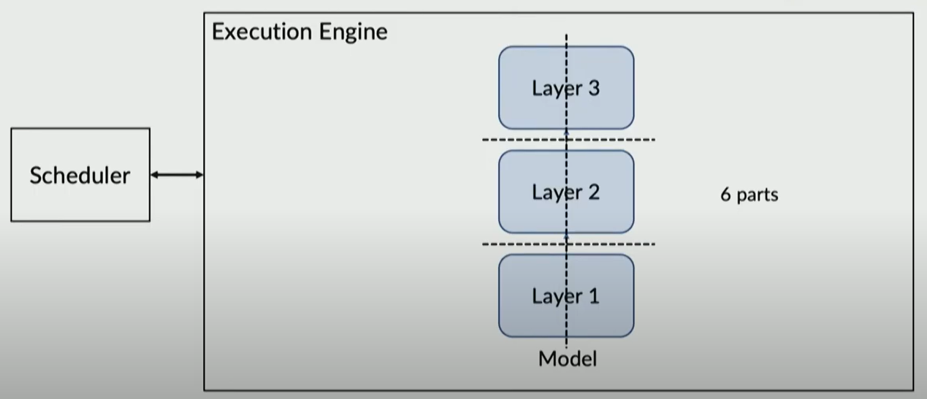
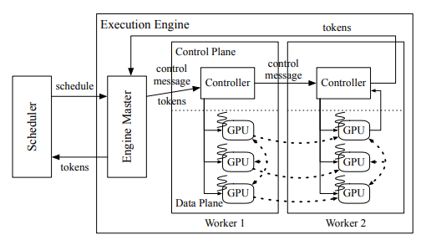
Orca: system architecture
Orca employs model parallelism and pipeline parallelism in a system similar to Megatron-LM¹ and FasterTransformer²
Scheduling is performed with a simple first-come-first-served algorithm and configurable max batch size
¹Megatron-LM. Retrieved Dec 13, 2021 from https: //github.com/NVIDIA/Megatron-LM.
²NVIDIA FasterTransformer. Retrieved Dec 13, 2021 from https://github.com/NVIDIA/ FasterTransformer.

Slide 15
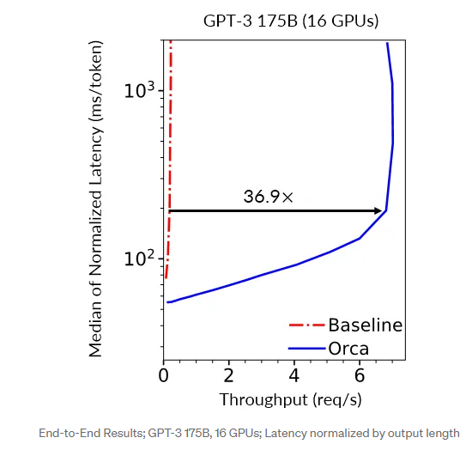
Orca: results
Orca outperforms FasterTransformer (baseline) under every level of load in terms of both latency and throughput
When providing the same latency on GPT-3 175B, Orca improved request throughput compared to FasterTransformer by 36.9x

Slide 16
Efficient Memory Management for Large Language
Model Serving with PagedAttention*
Woosuk Kwon, Zhuohan Li, Siyuan Zhuang, Ying Sheng, Lianmin Zheng, Cody Hao Yu,
Joseph E. Gonzalez, Hao Zhang, Ion Stoica
*SOSP 2023
Notes:
In the next paper, we present the PagedAttention algorithm, as well as the vLLM serving system built on top of this algorithm. The authors approach the issue of LLM serving efficiency through the angle of optimizing the KV cache.

Slide 17
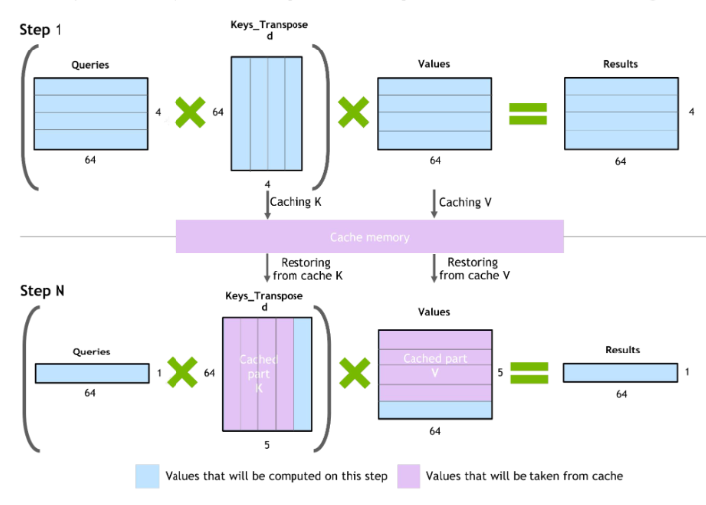
Transformer inference recap: KV Cache
Iteration 1
Iteration 2
Iteration 3
is
great
<eos>
Layer 3
Layer 3
Layer 3
Layer 2
Layer 2
Layer 2
Layer 1
Layer 1
Layer 1
I
think
this
is
great
https://developer.nvidia.com/blog/accelerated-inference-for-large-transformer-models-using-nvidia-fastertransformer-and-nvidia-triton-inference-server/
Notes:
Save attention keys and values of all previous tokens in KV cache
Q: What do you do in the case of cache misses? A: There typically are no cache misses because of the sequential nature of the attention computation

Slide 18
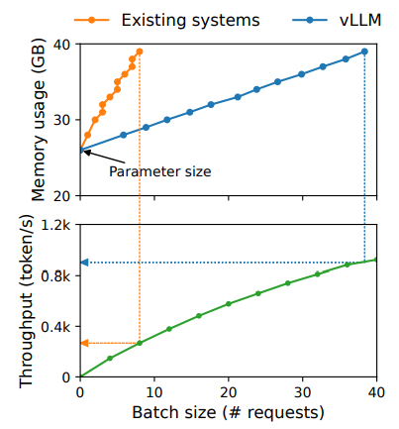
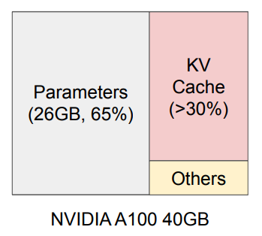
Key insight
The KV Cache grows quickly with the number of requests, on the order of GB/request
Efficient management of the KV Cache is crucial for high-throughput LLM serving

Slide 19
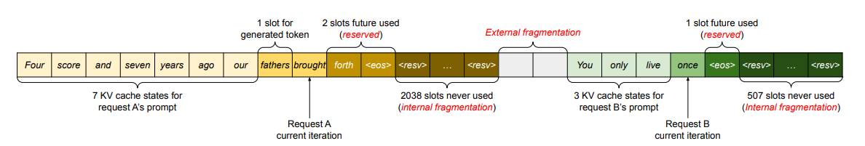
Memory inefficiency in KV Cache
Internal Fragmentation: over-provisioning due to unknown output length
Reservation: space allocated for future tokens, but not currently used
External Fragmentation: due to different sequence lengths
Only 20-40% of KV Cache is utilized to store token states
Notes:
Since most operators in current deep learning frameworks require tensors to be stored in contiguous memory, previous LLM serving systems like Orca also store the KV cache of one request as a contiguous tensor across the different positions. Due to the unpredictable output lengths from the LLM, they statically allocate a chunk of memory for a request based on the request’s maximum possible sequence length, irrespective of the actual input or eventual output length of the request.

Slide 20
“Any problem in computer science can be solved by adding indirection”
OS Memory Management
vLLM Memory Management
Physical RAM Address Space
Request A Logical KV Cache
Non-contiguous KV Cache on GPU vRAM
Process A Virtual Address Space
Page
0
0
Block
0
0
1
1
1
1
2
2
2
2
Page Table
3
Block Table
3
3
3
4
4
5
Request B Logical KV Cache
5
Process B Virtual Address Space
0
0
CPU
Disk
1
1
2
2
3
3
Notes:
Solution is to apply the concepts of VM and paging from OS to the KV cache
The vLLM scheduler maps logical memory (KV cache sequentially generated, which is contiguous) via a page table to non-contiguous memory on GPU memory and CPU for swapping (similar to virtual memory where the page table maps to the disk if RAM memory is not available).
So when we are inferencing, we can ask the contiguous logical memory to give us the KV blocks, and it can get us the cached KV matrices from the GPU or CPU memory, and then we can use it to compute attention.
One caveat is that the scheduler needs to reserve space in the memory (GPU or CPU) beforehand so that it can dynamically map the KV cache in the memory in the reserved space.
Q: Why would large block size result in significant increase of latency
A: If the block size is too large, internal fragmentation increases and the probability of sharing decreases

Slide 21
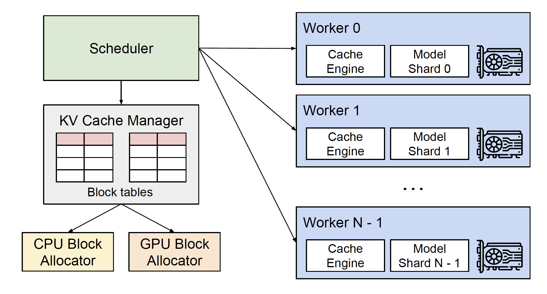
vLLM overview
Centralized scheduler to coordinate the execution of distributed GPU workers
KV cache manager effectively manages the KV cache in a paged fashion, enabled by PagedAttention.
Notes:
Single Program Multiple Data,

Slide 22
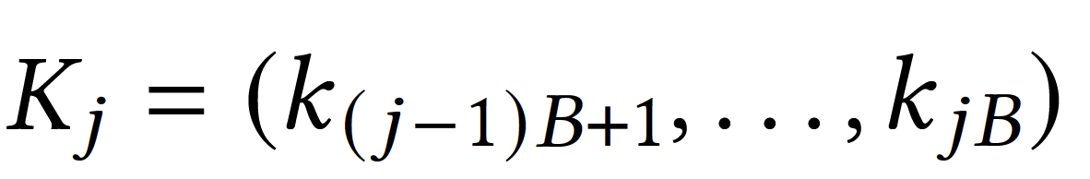
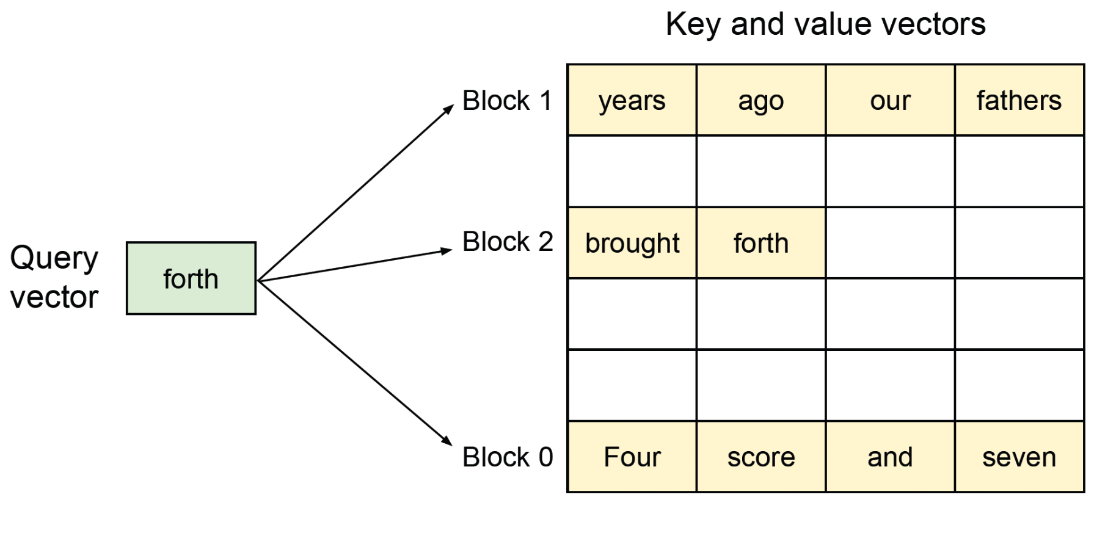
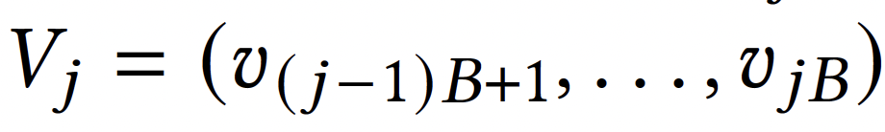
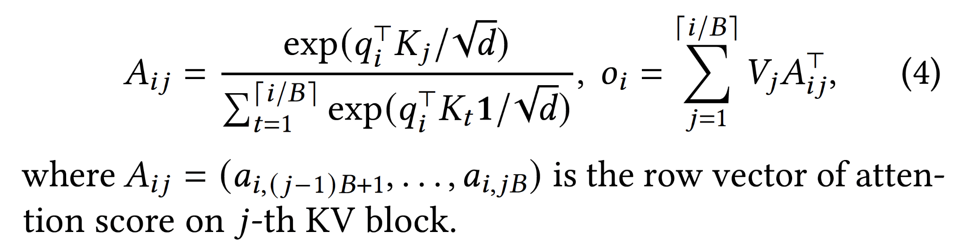
PagedAttention
Segments Key-Value matrices into different blocks
Enables attention key to be stored non-contiguously
Critical to handle variable-sized input

Slide 23
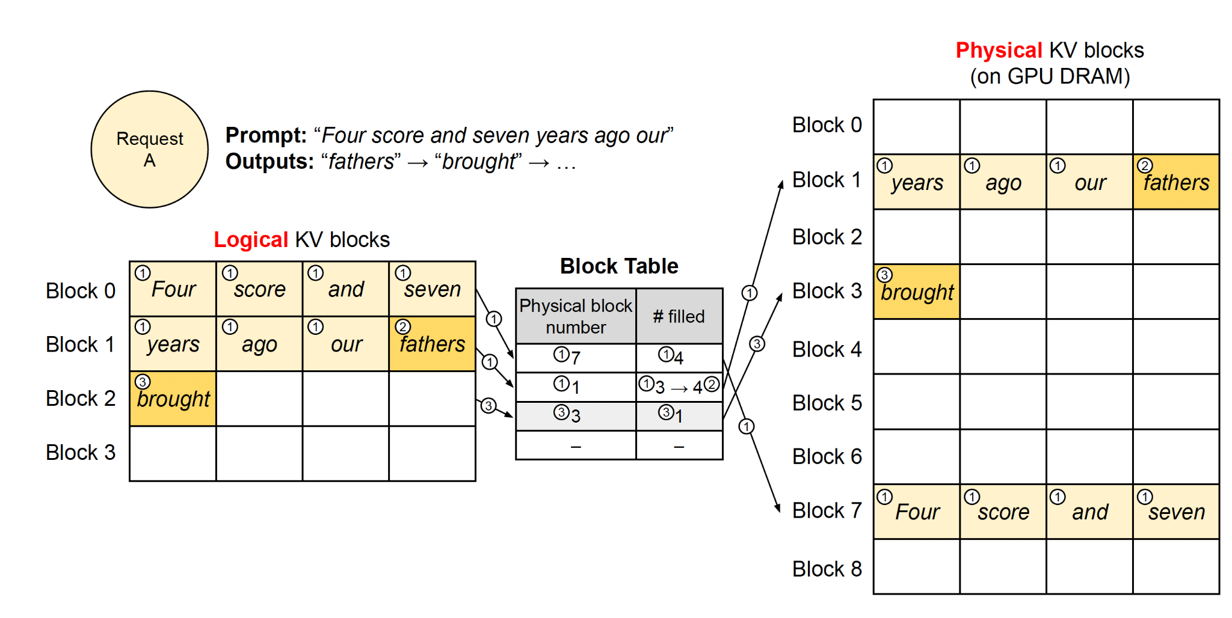
KV Cache manager / Decoding with PagedAttention
② Autoregressive decoding begins, fills last slot in Block 1
③ Allocate a new physical block 3 for second step in decoding
① vLLM does not need to reserve additional space for a max seq length.
Leaving one slot in Physical Block 1 unused
Notes:
- vLLM dynamically allocates memory for KV blocks as needed, similar to virtual memory systems, avoiding initial reservation for maximum sequence length.
- Initially, only necessary KV blocks are reserved based on prompt length; for a 7-token prompt, 2 logical KV blocks are mapped to physical blocks.
- During the prefill step, vLLM generates KV cache using conventional self-attention, storing the first 4 tokens' KV cache in one block and the next 3 in another, with space left for future generation.
- In the first decoding step, PagedAttention uses the existing physical blocks to generate a new token, updating the filled record in the block table as space is available.
- At the second decoding step, with the last logical block full, vLLM allocates a new physical block for the newly generated KV cache and updates the block table with this new mapping.

Slide 24
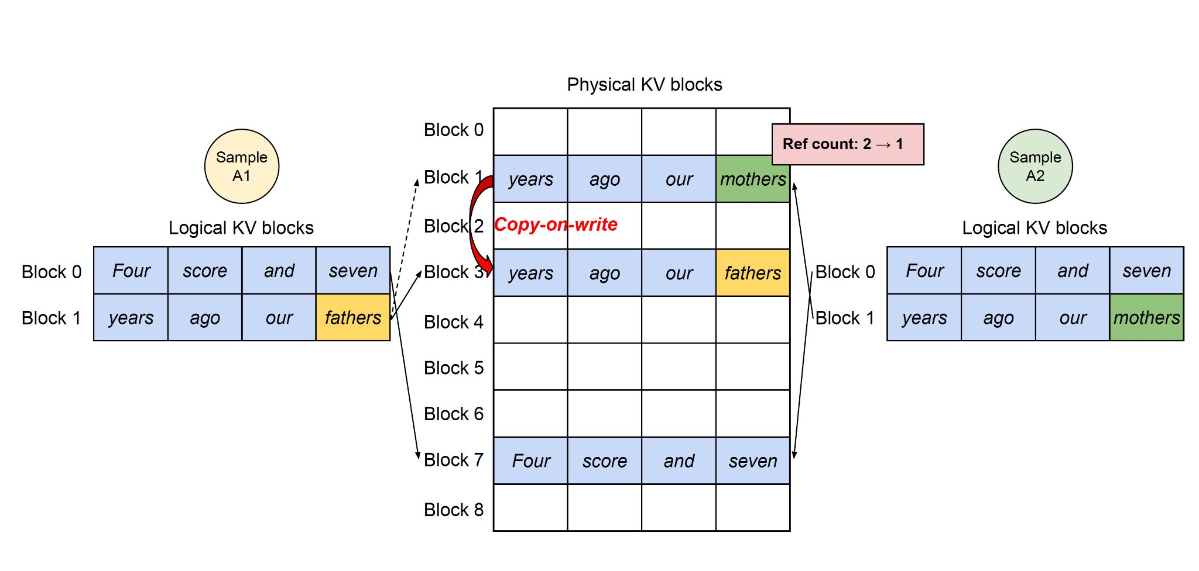
Memory sharing in decoding: parallel sampling
Notes:
Github Copilot
support fork

Slide 25
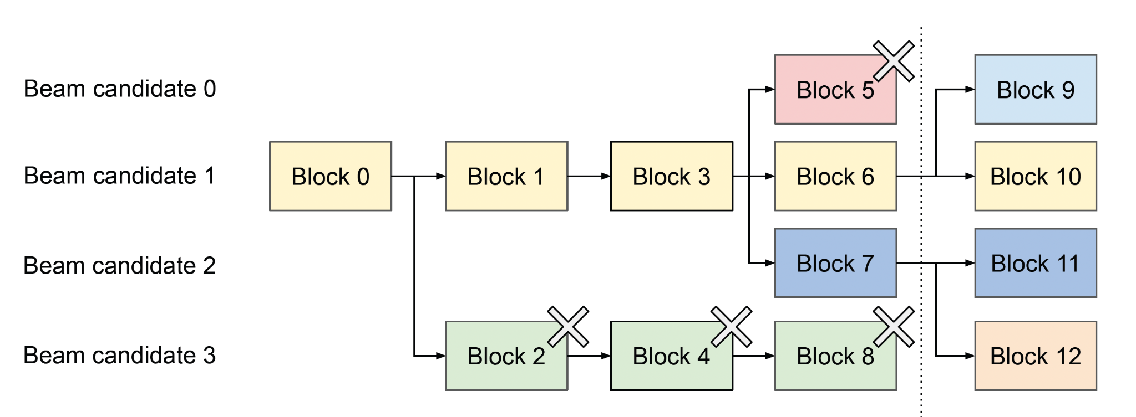
Memory sharing in decoding: beam search
Notes:
Searching for the most likely sequence

Slide 26
Scheduling and pre-emption
First-Come-First-Serve
Swapping to CPU RAM for eviction
All-or-nothing: either evict all or none of a block
processing a request requires all of its corresponding token states to be stored in GPU memory
Preemption may require recomputation
Notes:
The system employs a first-come-first-serve scheduling policy to ensure fairness among requests, which is crucial for maintaining consistent service levels.
- An all-or-nothing eviction policy is tailored specifically for the needs of large language models, meaning that a block is only evicted if the entire block can be cleared, preventing partial block usage and inefficiencies.
- When memory blocks need to be freed, the system can either recompute the evicted information or swap it out to a slower, more abundant storage medium, depending on the situation.

Slide 27
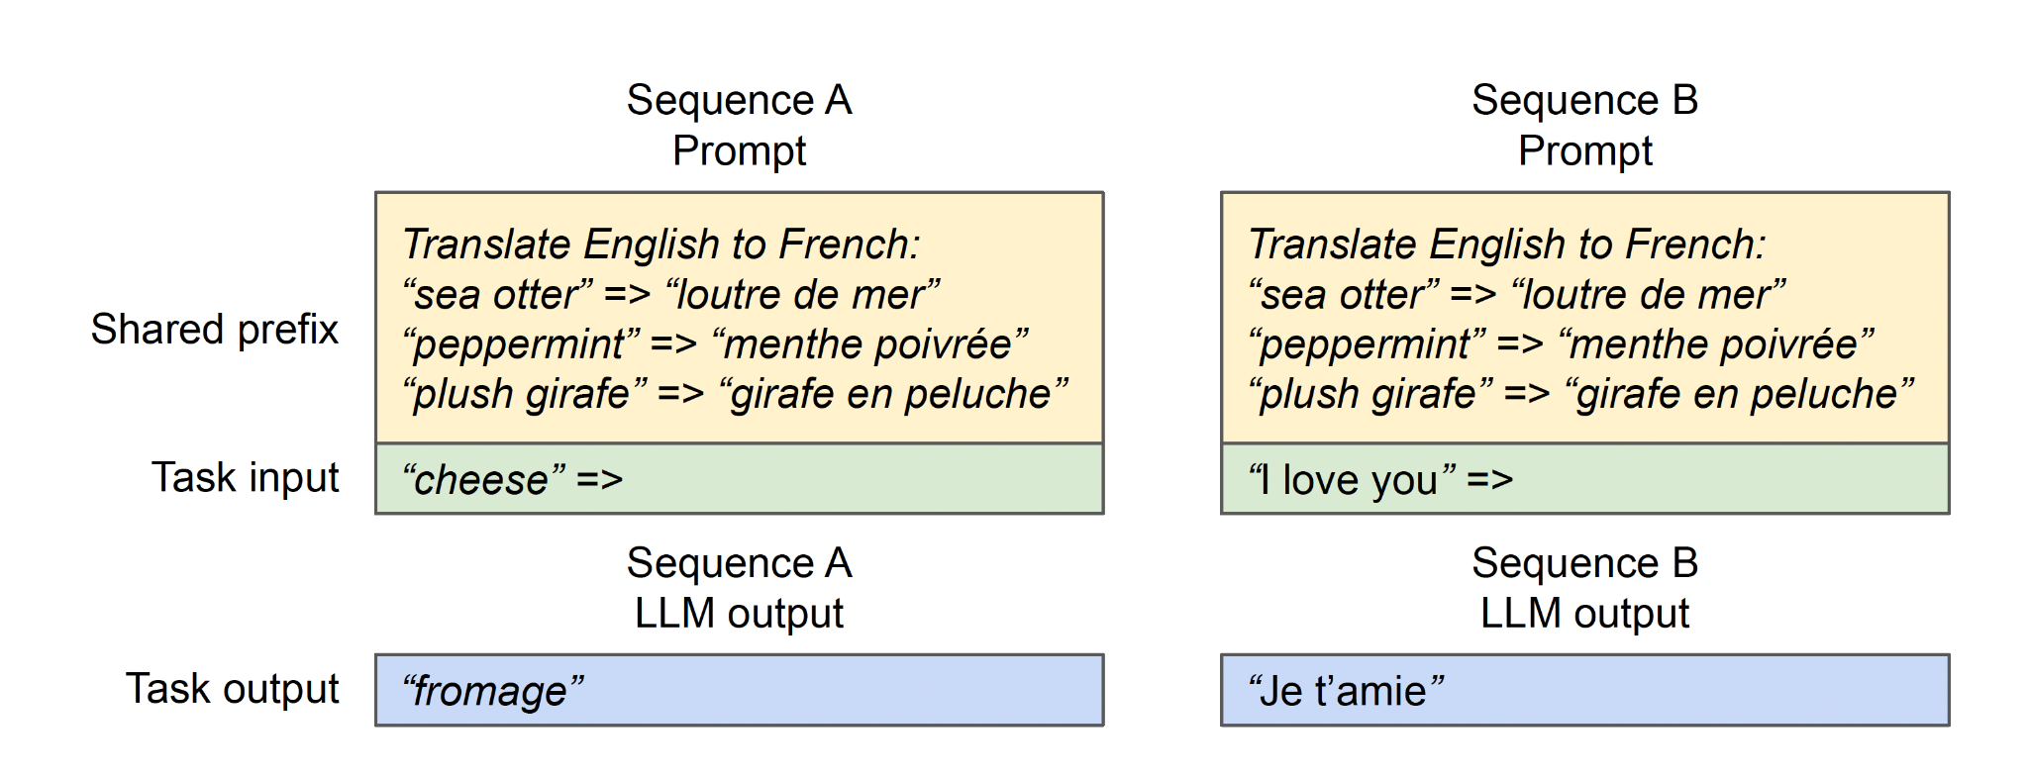
Prefix sharing
LLM usually concatenates user inputs in dialogues and system prompts. May Cache in Advance

Slide 28
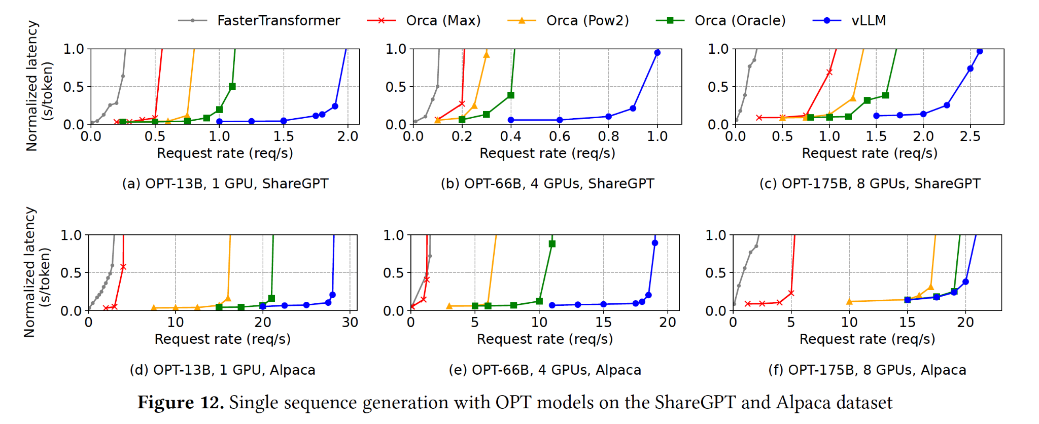
Results: tested on ShareGPT and Alpaca
Notes:
Second row alpaca
ShareGPT: chatGPT history, a plugin in Chrome that allows user to
Alpaca dataset is an instruction dataset generated by GPT- 3.5 with self-instruct
FastTransformer: Nvidia model
Orca (Oracle): We assume the system has the knowledge of the lengths of the outputs that will be actually generated for the requests. This shows the upper-bound performance of Orca, which is infeasible to achieve in practice

Slide 29
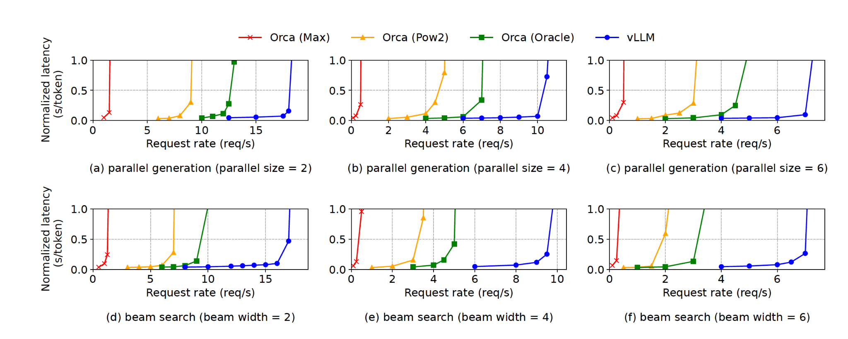
Parallel execution & beam search

Slide 30
Discussion and future extensions
Paging idea might only work for managing the KV cache in LLM
May not see an improvement in serving other ML architectures: e.g. Deep Neural Nets
Tensor shapes are usually static
Or if compute-bound problem rather than memory-bound
LLM-specific optimizations
All-or-nothing eviction
Recomputation method to recover the evicted blocks
which is not feasible in OS

Slide 31
Approximate Caching for Efficiently Serving Diffusion Models*
Shubham Agarwal, Subrata Mitra, Sarthak Chakraborty, Srikrishna Karanam,
Koyel Mukherjee, Shiv Kumar Saini
*Accepted at NSDI 2024

Slide 32
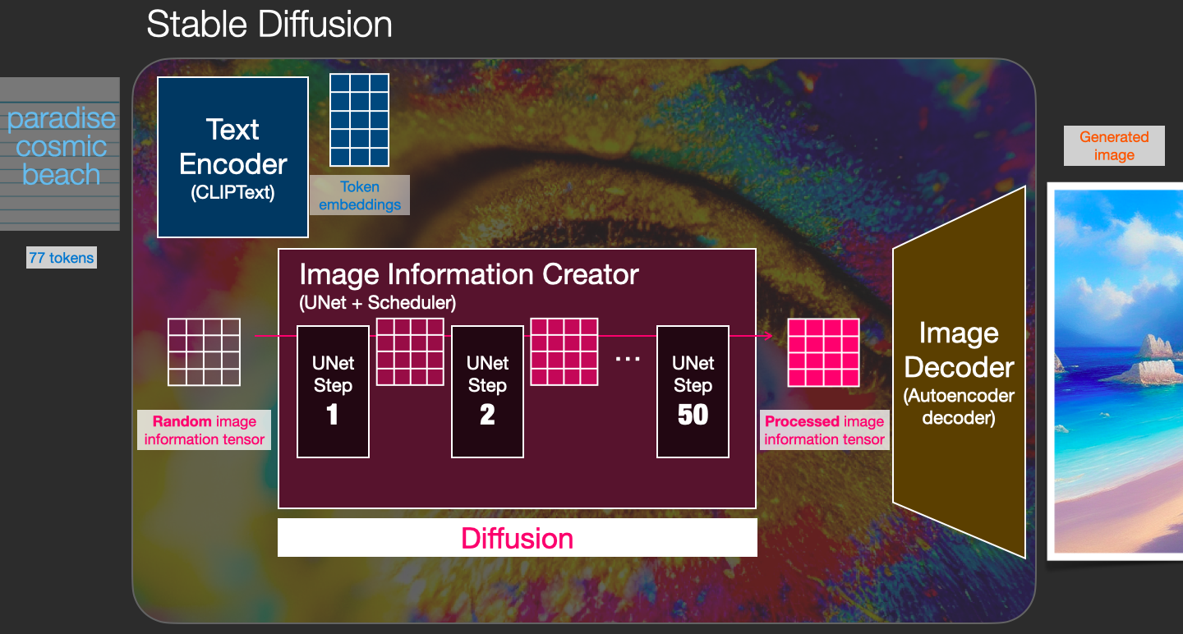
Recap: diffusion models for text-to-image generation

Slide 33
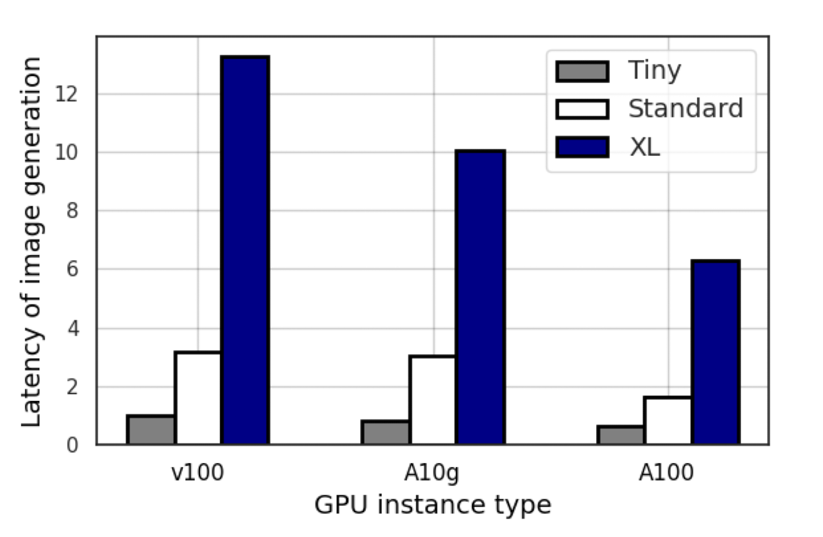
Problems with diffusion models
High latency for high-quality models (e.g., Stable Diffusion XL).
Speed vs. quality trade-off in smaller models.
High costs for powerful GPU instances (e.g., NVIDIA A100 $8.14 hr).
Variable efficiency in NIRVANA's approximate caching method.
Limitations compared to direct image retrieval systems (GPT-CACHE, PINECONE).
Notes:
Latency in Larger Models: Larger models such as Stable Diffusion XL produce higher quality images but come with a substantial latency overhead, leading to higher costs.
Trade-off Between Quality and Speed: Smaller models can offer lower inference latency, which is good for user experience, but this often results in a significant degradation in the quality of generated images.
Cost of Powerful GPUs: Reducing latency by using more powerful GPUs can be cost-prohibitive. For example, NVIDIA A100 GPUs are much more expensive compared to other models like A10g or V100 on AWS, with the A100 being 4 times costlier than the A10g and more than 10 times costlier than the V100.
Approximate Caching: The new method introduced, NIRVANA, differs from standard diffusion models, which iterate multiple denoising steps starting from Gaussian noise. NIRVANA aims to reduce compute and latency by using a cache of intermediate noises/states from similar prompts, but this method’s efficiency varies greatly based on the similarity of the prompts.
Limitations of Caching Systems: Unlike systems like GPT-CACHE or PINECONE, which propose retrieving an entire image from a cache based on the input prompt, NIRVANA retrieves an intermediate state and further tailors the generated image to the new prompt, which may lead to variations in the quality and latency savings depending on the available cached states

Slide 34
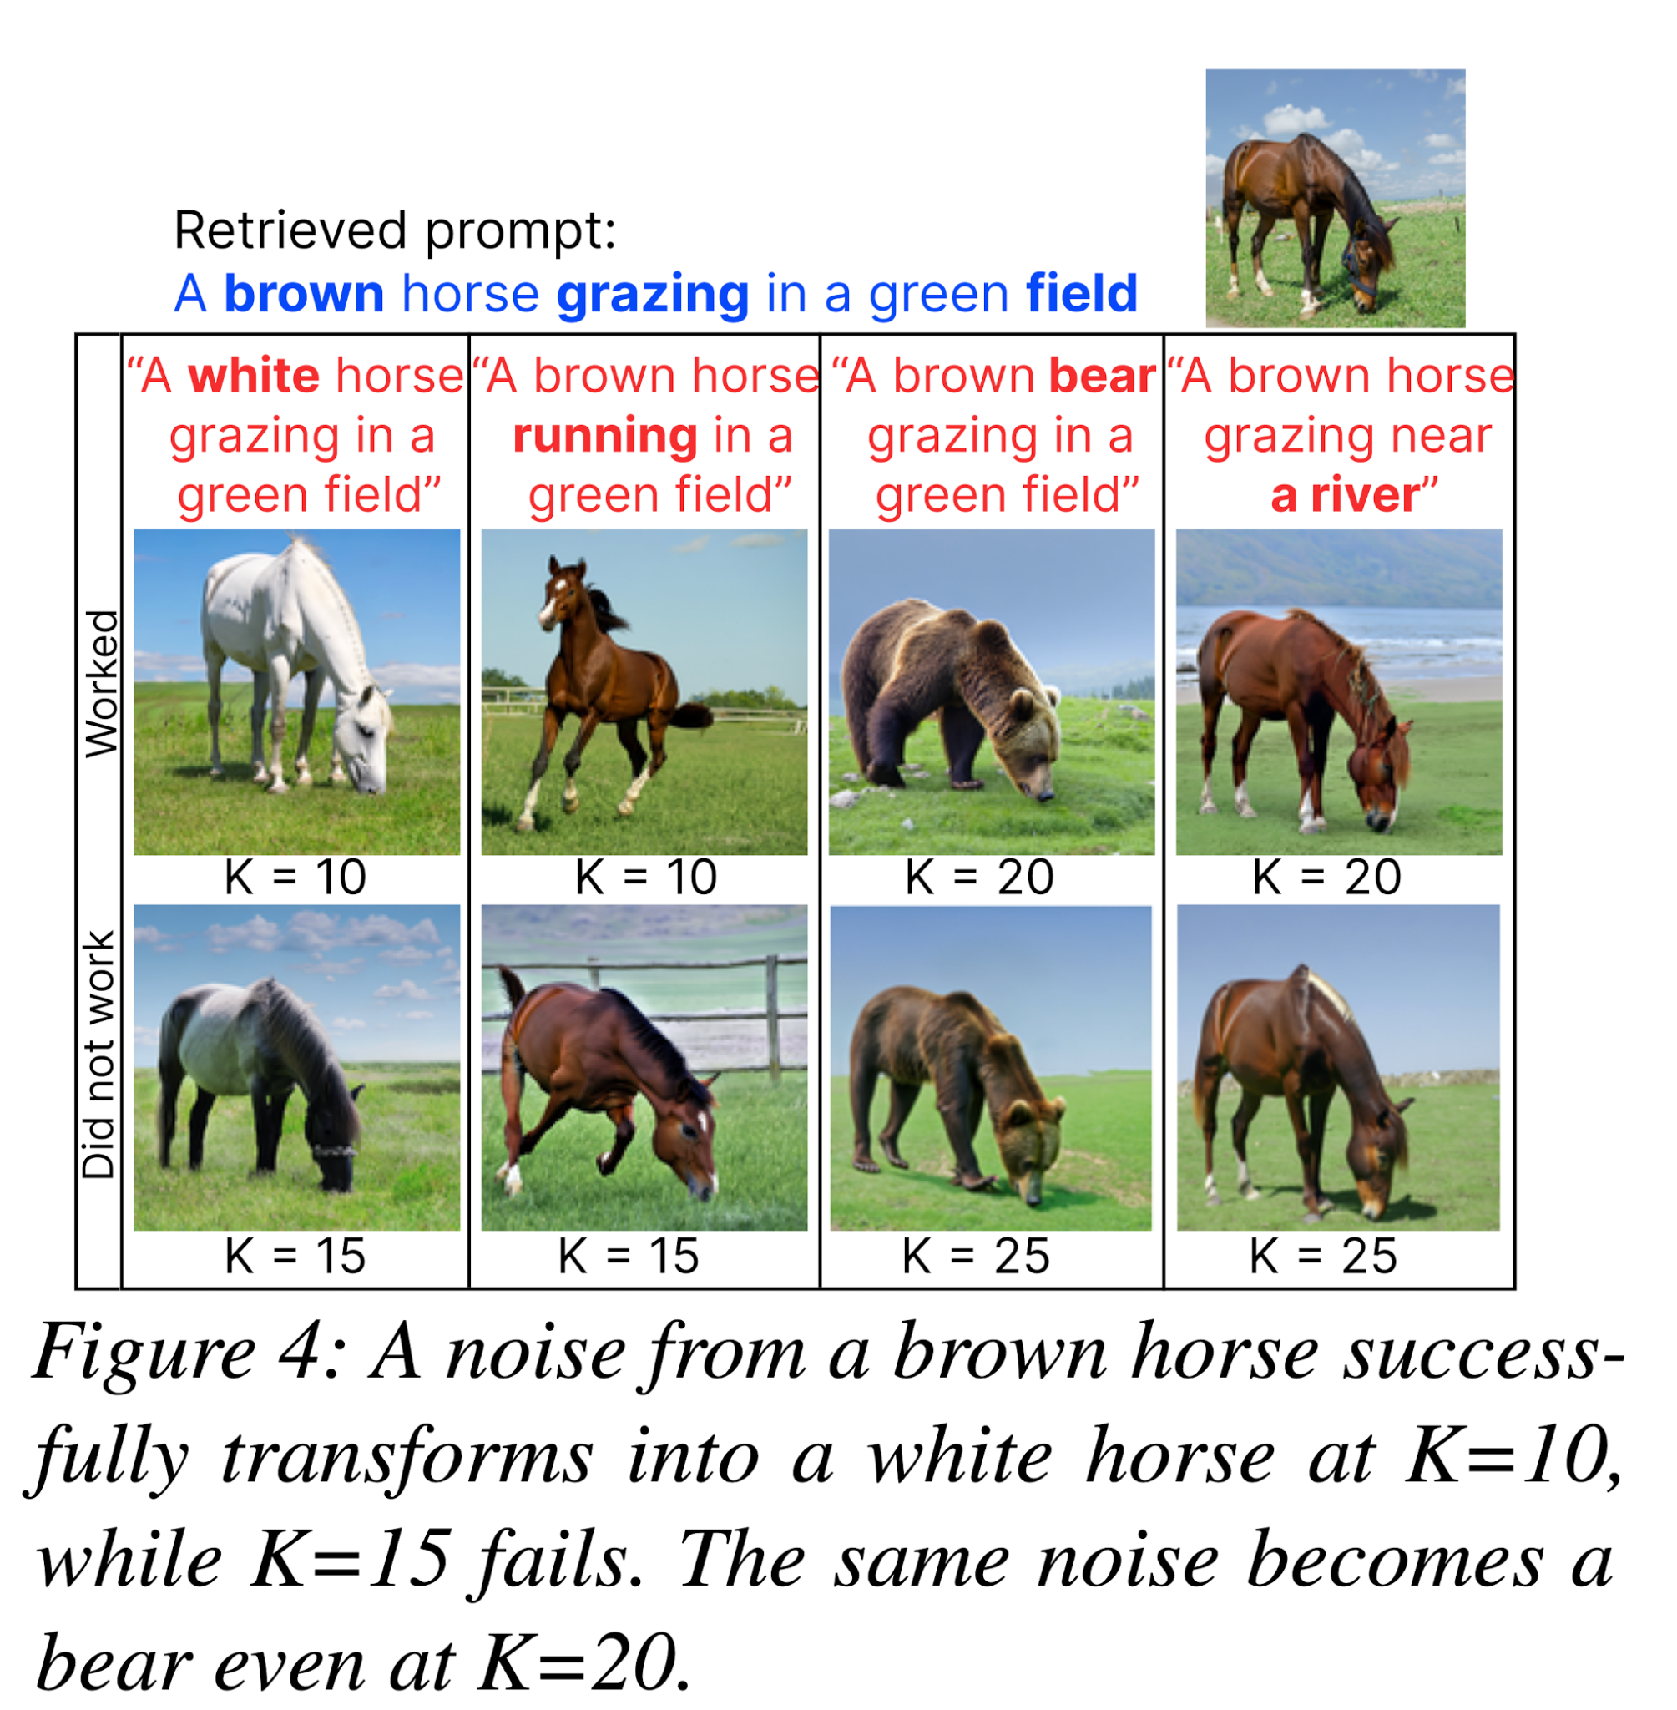
Dynamics of image generation
Reconditioning retrieved noise for a new prompt depends on the number of diffusion steps, denoted as K.
Characteristics like layout, color, shape, and style are difficult to alter after a certain point in the diffusion process.
Layout of objects determine ~20% of diffusion steps.
Color schemes, shape & style established by ~40%.
After ~50% of diffusion steps, image concepts become fixed
Notes:
Layout of objects in images is determined in the initial ~20% of diffusion steps.
Color schemes are established by ~40% of the diffusion steps, followed by object shape and size, then artistic style.
After ~50% of diffusion steps, image concepts become fixed, and no further reconditioning changes are reflected in the final image.

Slide 35
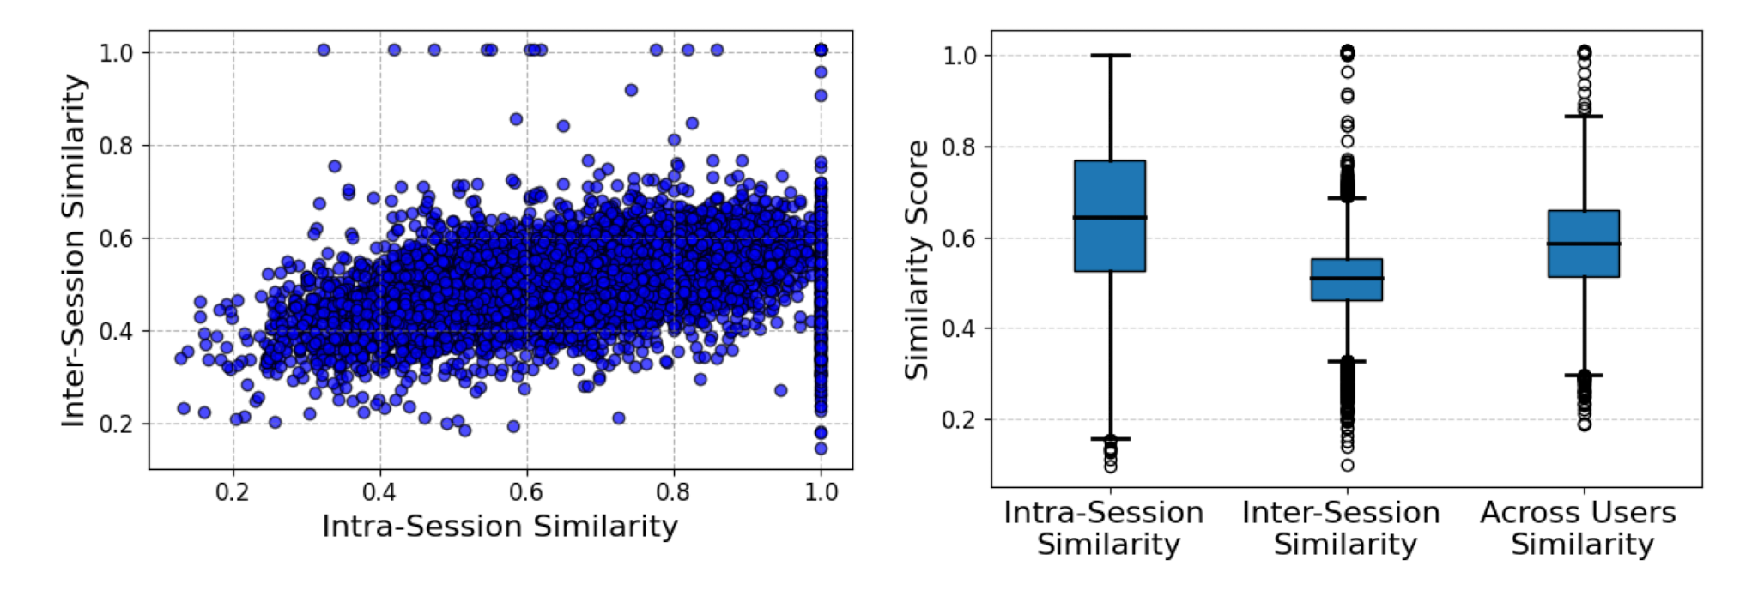
User prompts motivate cache-and-reuse
High intra-session prompt similarity observed, indicating repetitive patterns.
Significant inter-session and across-user prompt similarity, suggesting the potential for efficient approximate caching.

Slide 36
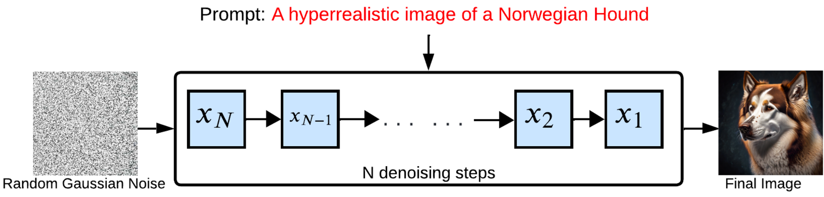
VANILLA diffusion model
Notes:
approximately 50-100 steps

Slide 37
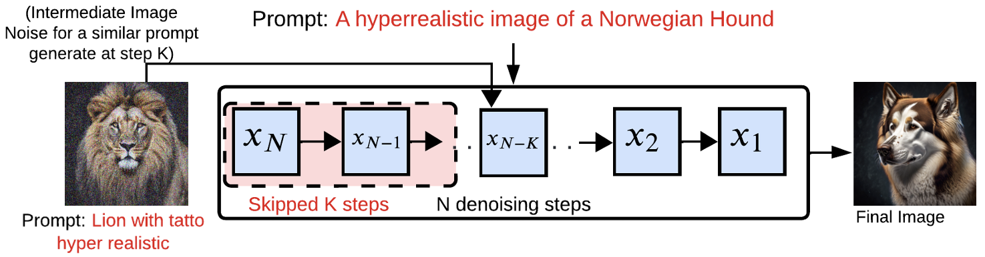
Approximate-caching diffusion model
reconditioning
Goal: reduce computation
retrieve intermediate state created after 𝐾^{th} iteration of a prior image generation process
recondition for this query prompt for the remaining 𝑁−𝐾 steps
Notes:
because the goal of approximate-caching model is to reduce computation and speed up this image generation latency
instead of starting from random noise, does this by taking the cached K-th step intermediate state corresponding to a previously generated image for a similar text prompt
and reconditions this intermediate state for the remaining N-K steps
they hypothesize that at certain K-”checkpoints” in the diffusion process, somewhat similar to in a CNN, certain subsets of features of the image are “perceived”/”learned”

Slide 38
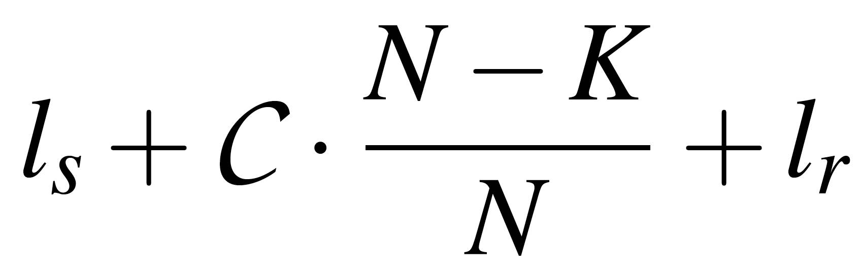
Approximate caching - analytical model
cumulative GPU computation time for steps
Notes:
while it seems that the paper’s analytical model wasn’t explicitly used to derive their system design, the model is important to
motivate and substantiate their intuition for higher K => higher compute/latency savings
show tradeoff between higher K (skip more steps) and image quality
if C := total GPU computation time for N steps (VANILLA diffusion), then because we skip first K steps, the modified GPU computation time is C * (N-K)/N

Slide 39
Approximate caching - analytical model
cache hit:
search Vector database (VDB) for similar cached prompt
cumulative GPU computation time for steps
Notes:
but we add the latency to do the vector similarity search on the vector DB for a similar cached prompt

Slide 40
Approximate caching - analytical model
cache hit:
search Vector database (VDB) for similar cached prompt
cumulative GPU computation time for steps
retrieve cached intermediate state from Elastic File Storage (EFS)
Notes:
and the latency to retrieve the K-th step intermediate state for this historical prompt from the EFS

Slide 41
Approximate caching - analytical model
cache hit:
search Vector database (VDB) for similar cached prompt
cumulative GPU computation time for steps
retrieve cached intermediate state from Elastic File Storage (EFS)
cache miss:
Notes:
in the case of cache miss, you still incur cost to search VDB, but C for VANILLA diffusion for all N steps

Slide 42
Latency model
𝓛 = · ( )
+ (1 - ) · ( )
hit rate?
hit rate?
Notes:
We want to compute the hit rate so that we can model the latency, for this K

Slide 43
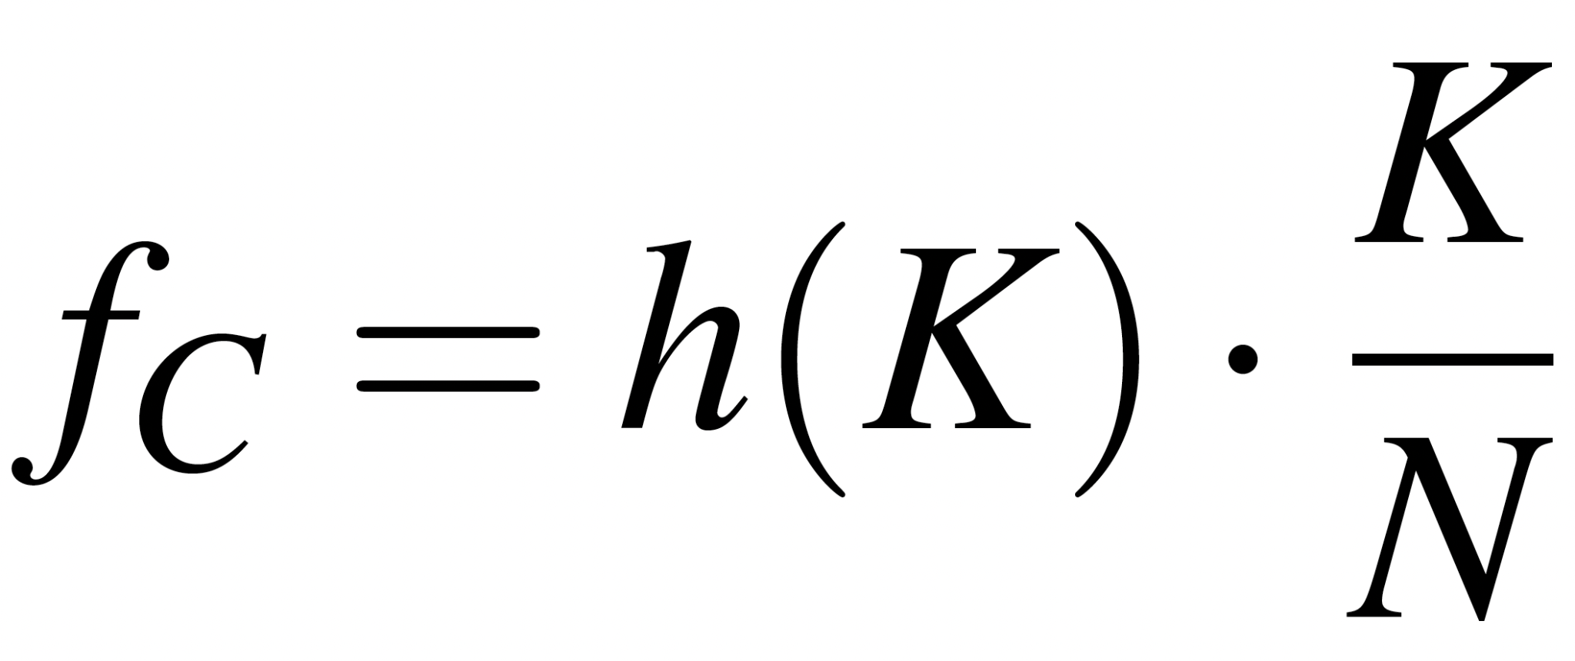
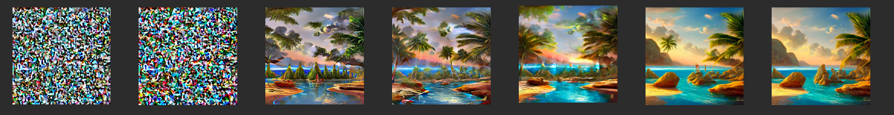
Hit rate?
Compute savings for 𝐾:
hit-rate@𝐾
𝘩(0) = 1.0
𝘩(𝐾 ≥ 𝐾_{𝘛}) = 0
𝘩_{opt}(𝐾-1)
𝘩_{opt}(𝐾)
𝘩_{opt}(𝐾+1)
𝘩(𝐾)
Images from The Illustrated Stable Diffusion - Jay Alammar, Nov 2022
Notes:
h(K) := fraction of cache that can be reconditioned to desired image, with at most N-K steps
h_opt(K) := fraction of cache that can be reconditioned to desired image, with exactly N-K steps
f := effective fraction of savings in GPU computation for a given K
the slower the decay of h(K) with respect to K the higher the compute savings we can expect

Slide 44

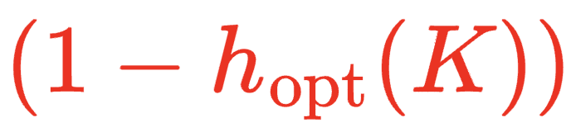
Latency model - updated
𝓛 = · ( )
+ (1 - ) · ( )

Slide 45
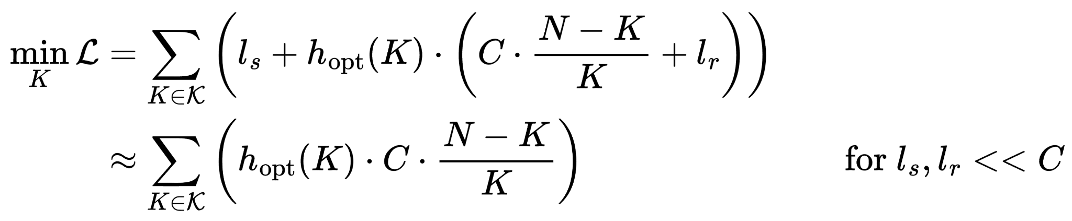
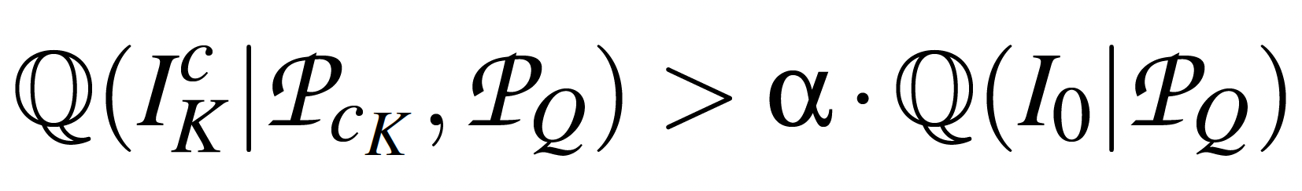
Objective (𝐾 that minimizes latency cost 𝓛):
Quality constraint (CLIPScore):
image generated by using cache
𝑐 at 𝐾 and then reconditioning for 𝑁−𝐾 diffusion steps.
= 0.9 (tolerance threshold)
Notes:
Here, we show two things:
Objective function effectively maximizes K and h_opt(K).
NOTE*: wasted overhead = ( 1 - h_opt(K) ) x l_s => NIRVANA may not provide latency benefits if l_s is comparable to GPU compute latency C
There is a tradeoff between maximizing K/h_opt(K) and adhering/satisfying to a certain quality (CLIPScore used due to its widespread use in evaluating image quality)

Slide 46
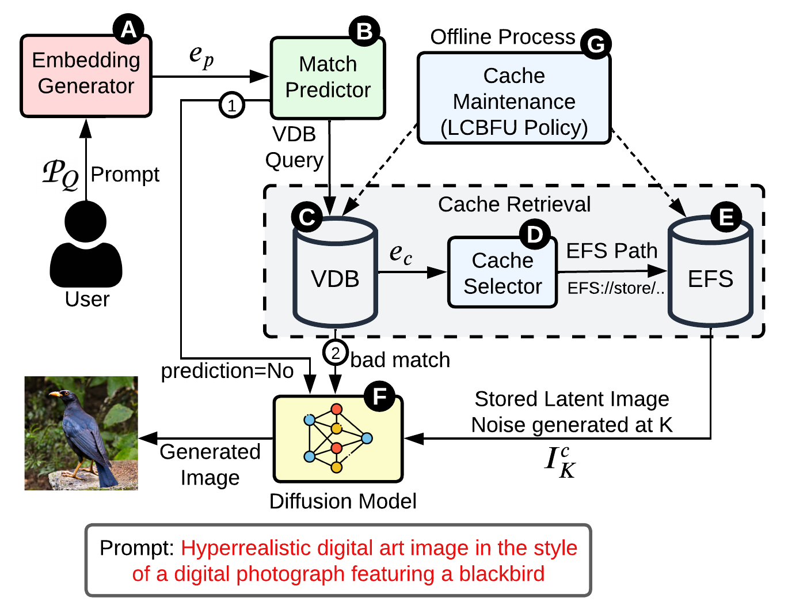
NIRVANA design

Slide 47
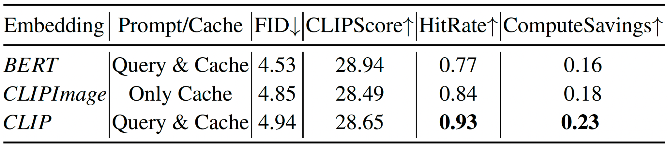
Embedding generator
768-dimensional vector CLIP embedding 𝑒_{𝘱} from text prompt
positions visually similar prompts in embedding space
Notes:
The text prompt is first encoded as a CLIP text embedding (due to good hit rate and compute savings compared to alternatives).
CLIP effectively positions visually similar prompts closer in the embedding space, which optimizes the likelihood of cache hits
CLIP text embeddings give best hit rate, compute savings
hit rate and compute savings achieved with the CLIP Text embeddings significantly outperform the other two embedding types.
Hence, we selected CLIP Text embeddings for our system design.

Slide 48
Match predictor
speculate whether it will be cache hit
i.e., if embedding 𝑒_{𝑐} close enough to 𝑒_{𝘱} will be present in VDB
uses lightweight SGDOneClassSVM sklearn classifier
achieves precision 𝑐_{𝘱} = 0.95 for real production prompts
if yes:
go to cache retrieval flow
else if no:
bypass cache retrieval flow, save latency overhead (1-𝘩(𝐾))ᐧ𝘭_{𝘴} (which could be large)
Notes:
Rather than immediately querying the Vector DB for similar historical text prompts, the match predictor tries to predict whether there will be any similar cached prompts.
It uses a OneClassSVM classifier that is trained on all prompt embeddings (~300k unique prompts) in the VDB,
assigning them a positive label of 1.
To achieve a high precision and recall, we effectively overfit the model to the existing prompt embedding space.
retrained when >5% change in VDB prompts (i.e., >5% have been evicted)
simply incrementally retrain via SGD (that can just incrementally retrain with new data point(s), and not from scratch)

Slide 49
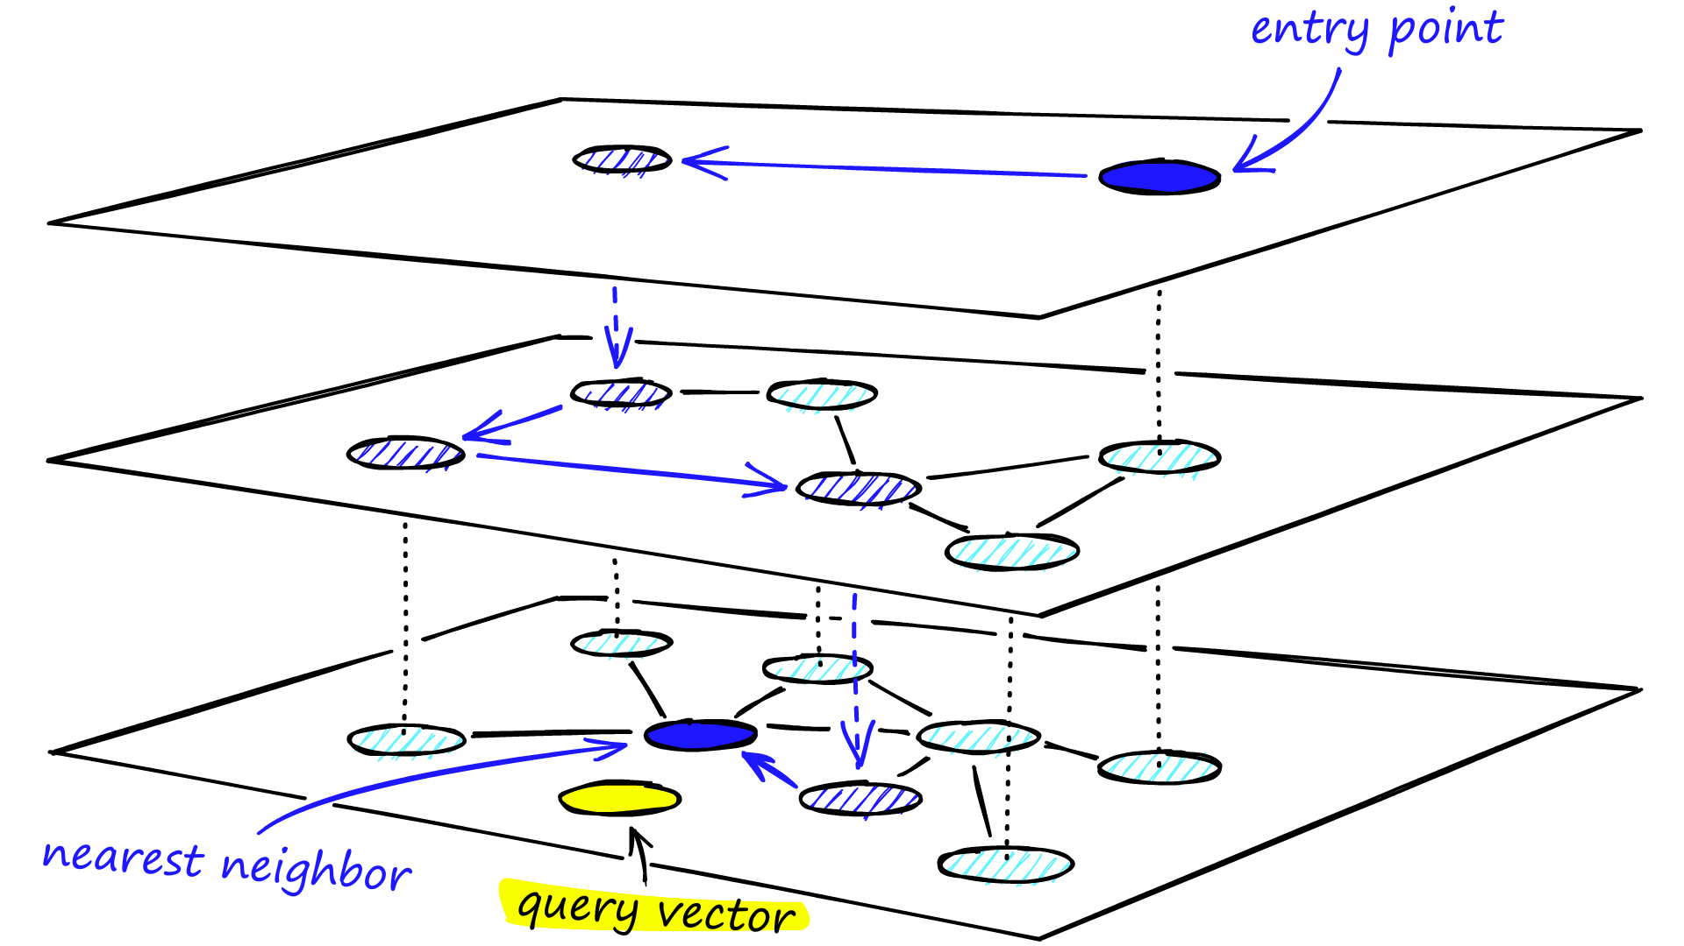
Cache retrieval
VDB stores embeddings of the cached historical prompts 𝑒_{𝑐}
fast and efficient cosine similarity search against incoming prompt 𝑒_{𝘱}
Qdrant on AWS m5.4xlarge EC2 instance with HNSW indexing
AWS Elastic File System (EFS) stores actual intermediate noise states
5 intermediate states of size 144KB each
𝒦 = {5, 10, 15, 20, 25}
Cache selector chooses 𝐾 ∈ 𝒦 to retrieve
via offline profiling
Hierarchical Navigable Small Worlds (HNSW) - Pinecone, Oct 2021
Notes:
If the match predictor thinks that there will be at least one previous prompt that has high similarity to the input prompt, the system searches its Qdrant VDB for this historical prompt.
Qdrant - low read latency at scale and moderately low update and delete latency
uses good indexing methods to store and perform high-dimensional similarity search (e.g., Hierarchical Navigable Small World (HNSW) graph indexing)
The cache selector chooses a Kth-step, and the system retrieves from EFS the actual Kth-step intermediate noise state
AWS - good read latency, throughput and storage cost

Slide 50
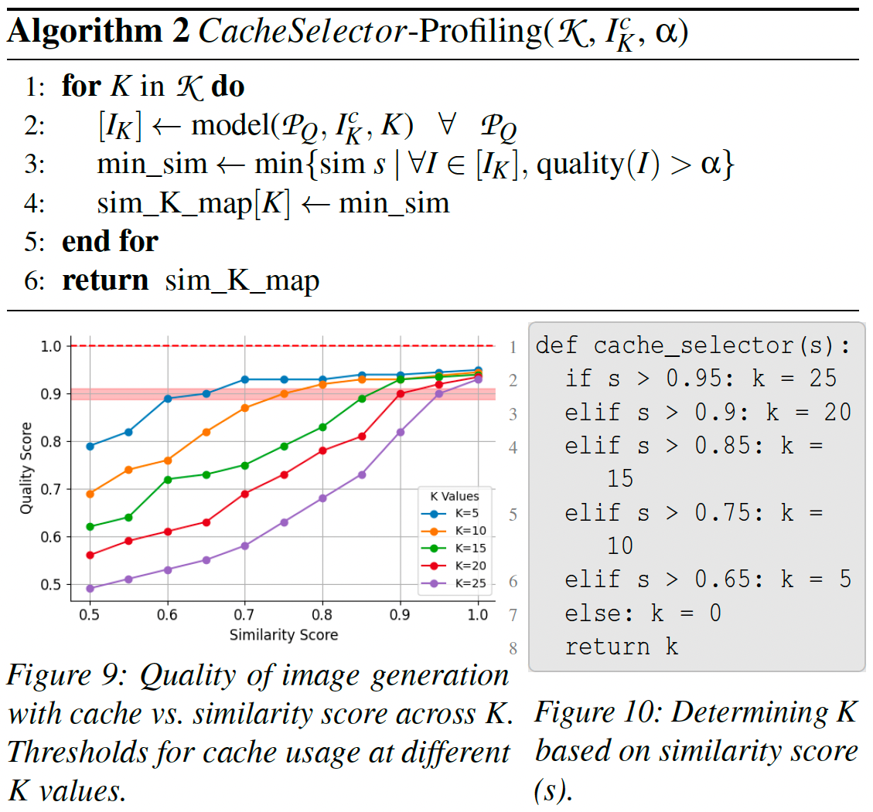
Cache selector profiling
compute similarity score 𝘴(𝑒_{𝘱}, 𝑒_{𝑐}) via 𝑒_{𝑐} from VDB
use inverse of sim_K_map to search for max 𝐾 such that 𝘴(𝑒_{𝘱}, 𝑒_{𝑐}) ≥ 0.9 = 𝛼
note: if this 𝐾 not available (due to LCBFU eviction), choose largest 𝐾’ < 𝐾
Notes:
Essentially, the cache-selector generates the right figure offline.
appropriate 𝐾 such that the 𝐾th-step intermediate-state is optimal based on the ℚ similarity score between the two prompt’s embeddings
2: generate images for set of prompts with their nearest cache prompt
3: minimum similarity score such that all generated images are above a quality threshold
quality(I) := Q(I_K, P_Q) / Q(I_0, P_Q)
Each line in the figure, corresponding to different K values, intersects this red band at the specific similarity scores above which that particular K value is applicable.
Thus, if similarity score is high, we can skip a greater number of diffusion steps and choose higher K to achieve acceptable image quality. But, if similarity score is low, we can skip only a limited number of iterations and hence, a lower K.
2. use inverse of sim_K_map to search for min 𝐾 such that 𝘴(𝑒𝘱, 𝑒𝑐) ≥ 0.9 = 𝛼
=> use fixed profiled values for K (observable from the figure); e.g., if s > 0.95: k = 25 elif s > 0.9: k = 20 …

Slide 51
Cache maintenance
Least Computationally Beneficial and Frequently Used (LCBFU) eviction policy
can’t have unlimited historical prompt cache (storage costs, VDB performance) => limit 1 TB (1.5 million states, 300k unique prompts)
Rationale
high 𝐾: high compute savings, but usable only with high similarity
low 𝐾: usable with wider variety of prompts, but low compute savings
𝑓_{𝑖} × 𝐾_{𝑖}
access frequency
Notes:
Ideally, we’d just store all historical prompts and intermediate noise states, so that we can freely pick and choose the best one to recondition from.
But in the real world, we don’t have infinite resources.
So we need some sort of cache eviction policy. The paper comes up with LCBFU because traditional policies like LRU, LFU, FIFO are bad because they treat each item homogeneously and only focus on access patterns or arrival sequence while evicting; whereas we need to also consider potential compute benefit (i.e., savings) in case of hit
NIRVANA can limit cache size to 1TB without degrading performance or quality.

Slide 52
LCBFU eviction policy
Insertion
insert all |𝒦| intermediate states to cache-storage
insert corresponding prompt embedding to VDB
Eviction
maintain LCBFU-score min heap
evict top |𝒦| items before inserting |𝒦| intermediate states for new prompt
holes are handled at cache-selector by simply choosing next best 𝐾
Notes:
insertion. Note: always all 𝐾 ∈ 𝒦 states are inserted. If full, evict until can insert
eviction. Loss in compute savings due to holes arise in only 4-5% of the prompts in practice

Slide 53
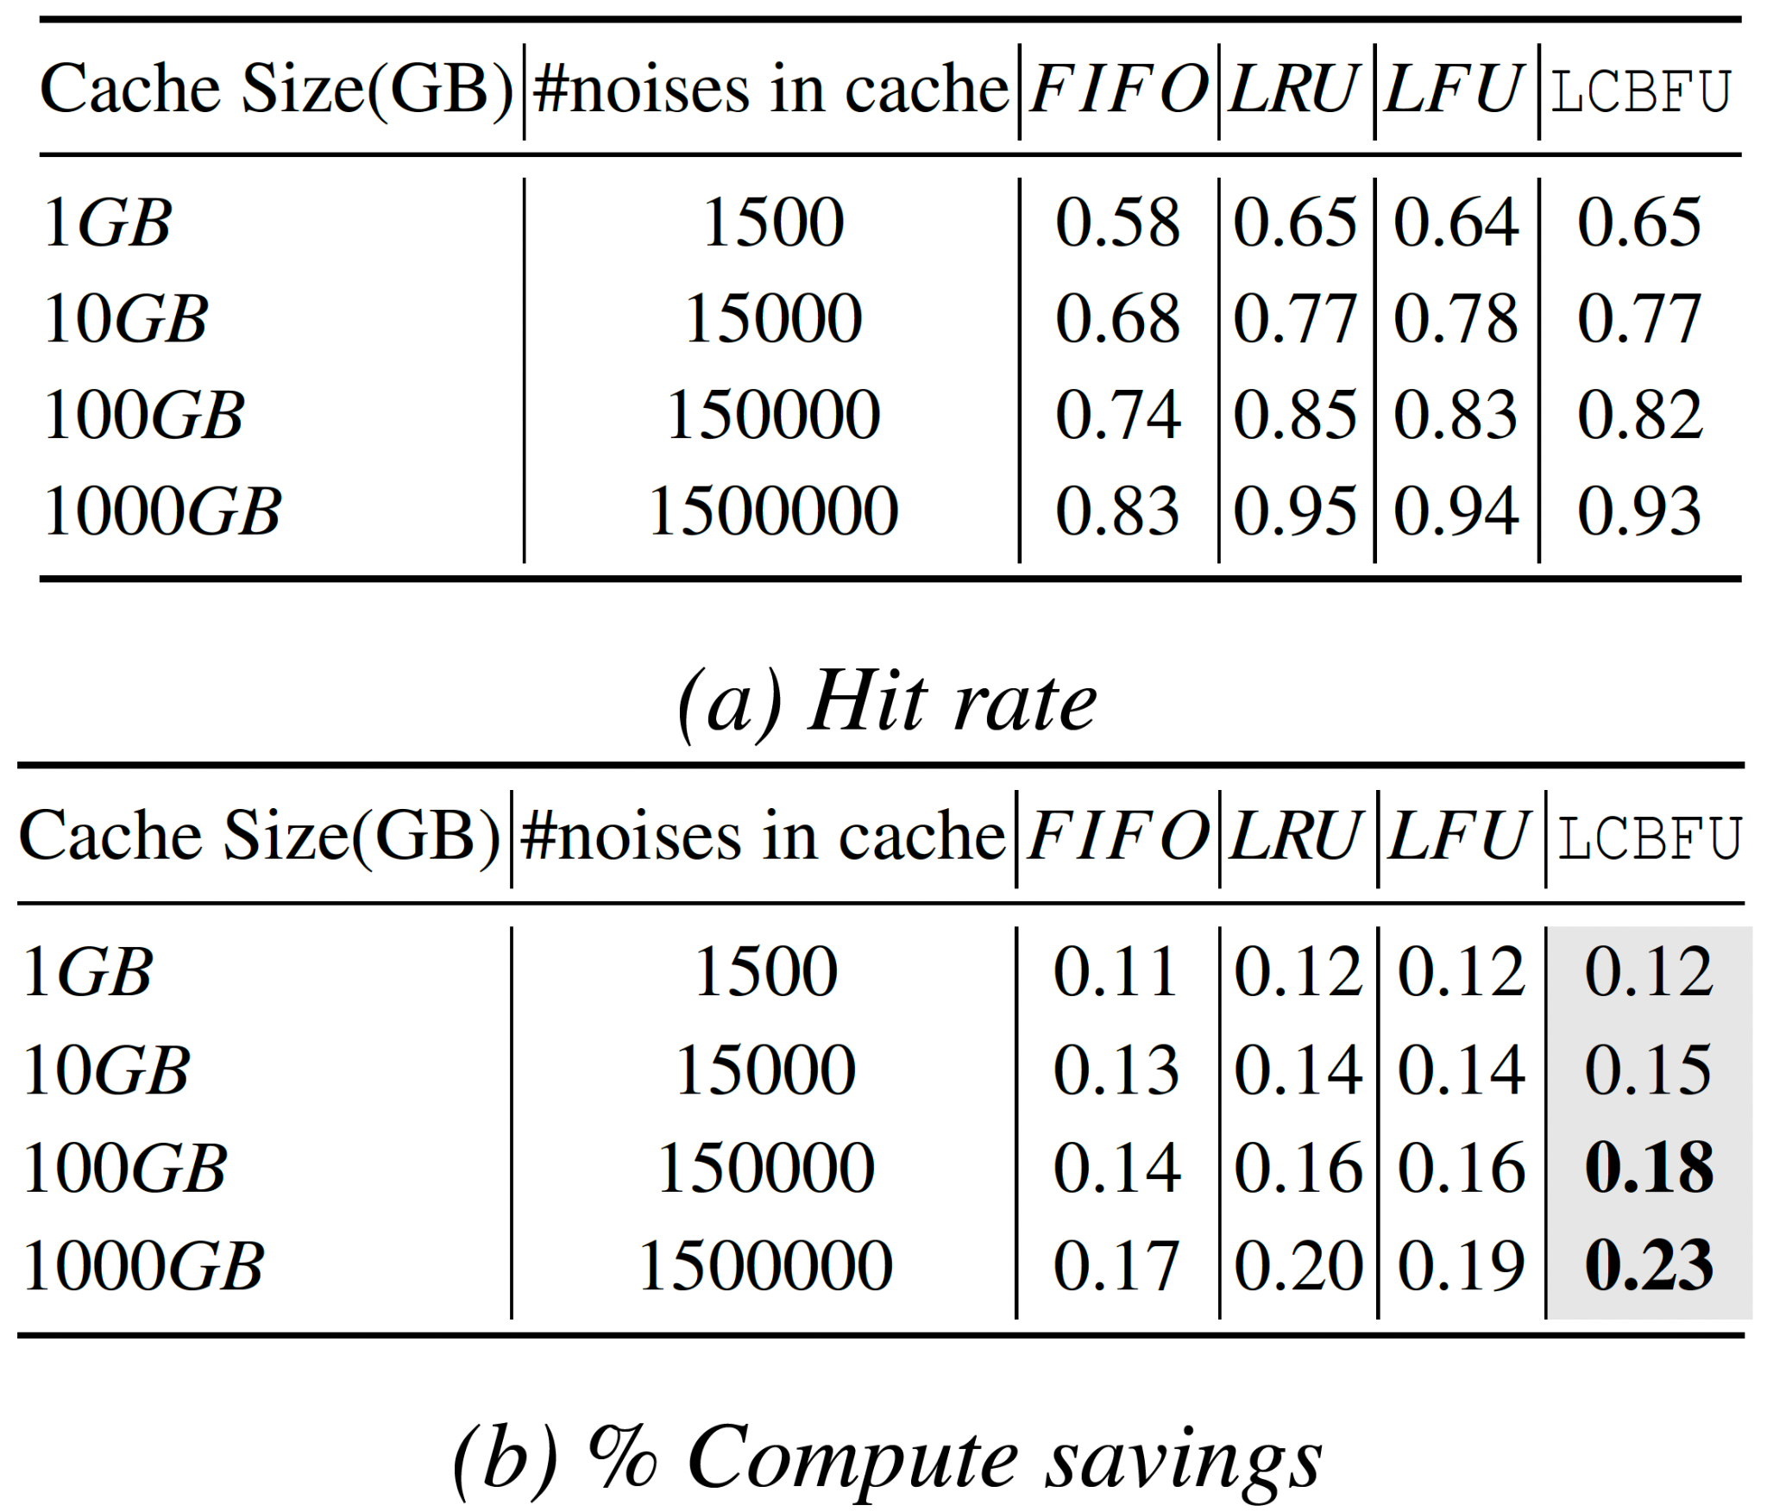
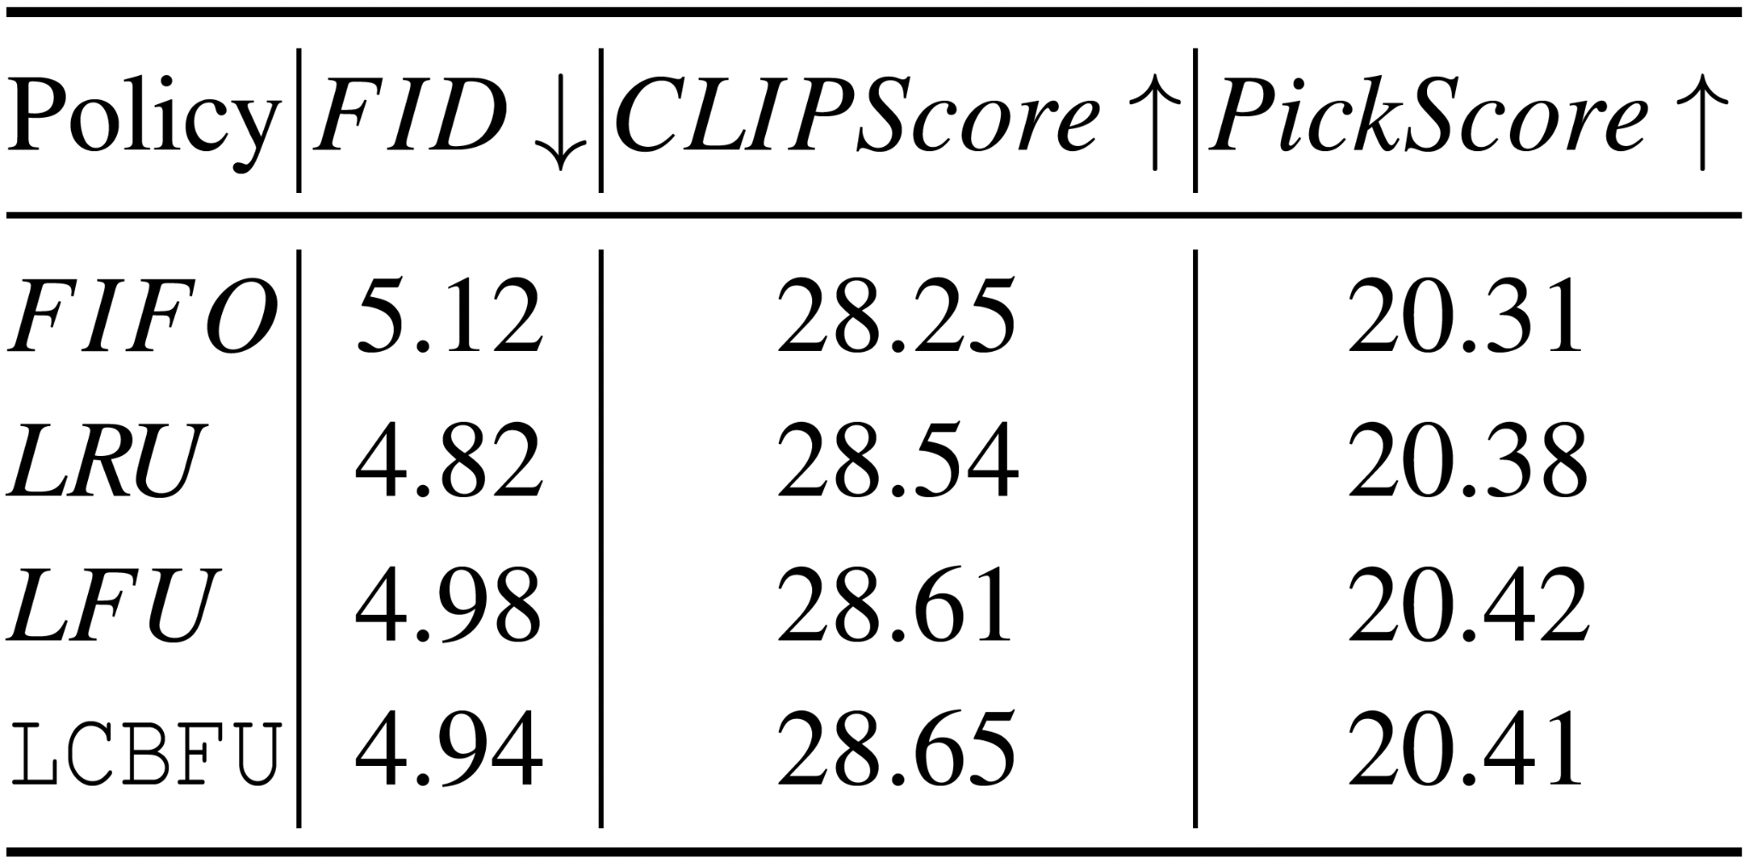
LCBFU vs. other eviction policies
Image quality comparison, 1500 GB cache

Slide 54
Evaluation
Overall effectiveness
high quality while reducing GPU usage, end-to-end latency, cost; and increasing throughput
User study to assess (qualitative) quality
good parity with VANILLA model
Notes:
Overall effectiveness
high quality while reducing GPU usage (compute) and end-to-end latency by up to 50%
reduces cost, latency, and compute requirements of diffusion-model by ~20% on average
27% improvement in system throughput
User study to assess (qualitative) quality
good parity with VANILLA model
Ablation studies (sensitivity analysis)
embedding type

Slide 55
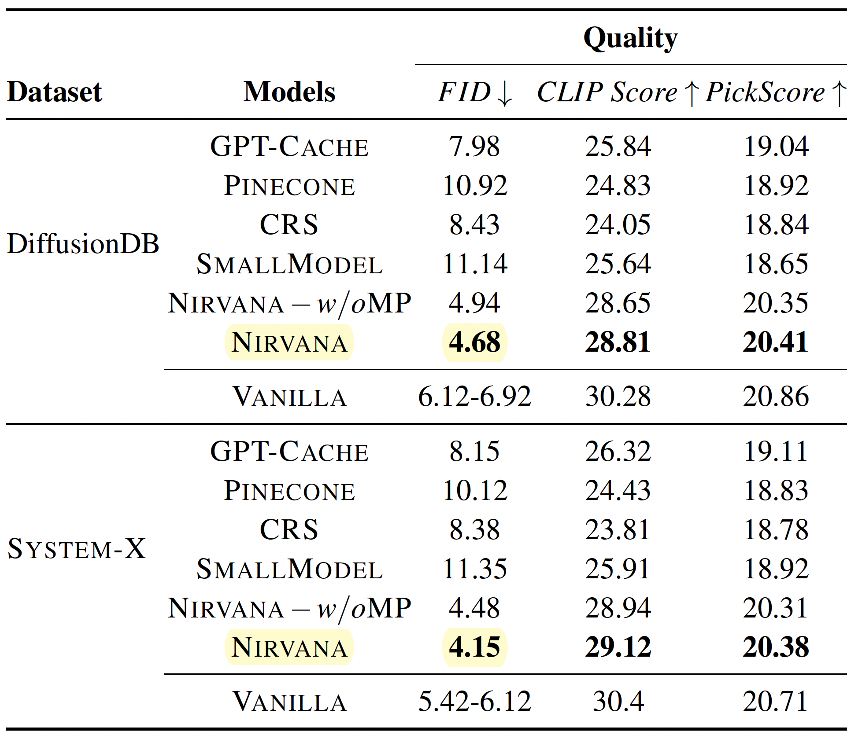
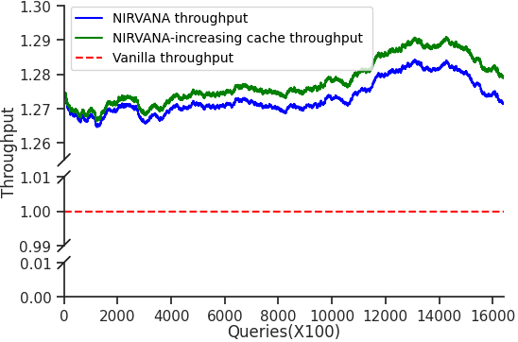
High quality and throughput
throughput :=
prompts processed per minute

Slide 56
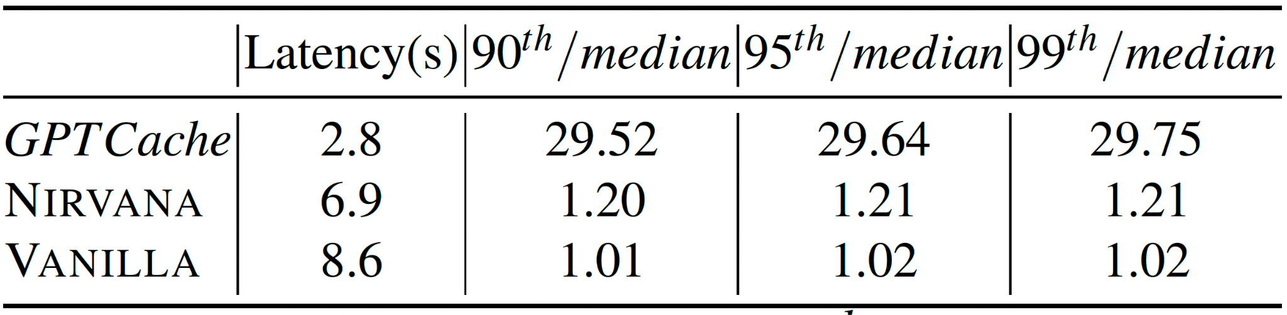
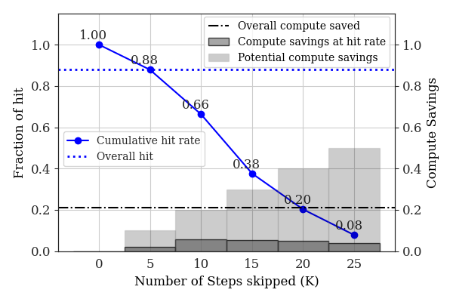
Reduced compute and latency
Notes:
Average latency and nth percentile over median values of the response latencies for approaches
reduces overall latency compared to VANILLA
NIRVANA reduces variance in latency compared to baselines
cumulative hit-rate curve illustrates how the hit-rate varies with different values of K and plots h(K).
bar plot showcases the potential savings achievable at each K and the actual savings realized at specific K values. For instance, at K = 25, there is a potential savings of 50%, while the actual hit-rate is 8%, resulting in an actual savings of 4%.

Slide 57
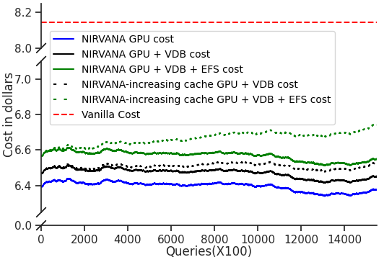
Reduced cost

Slide 58
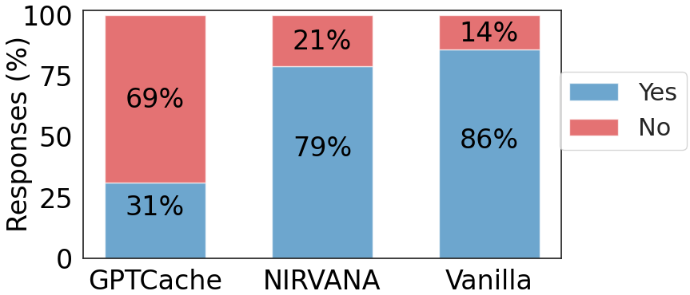
NIRVANA close to VANILLA in user acceptance
60 participants, 1000 randomly chosen prompts from DiffusionDB
Notes:
each user was presented with 15 random <prompt, generated-image> pairs and were asked to vote Yes, or No if they feel the generated image properly represents the given prompt
5 generated by GPT-CACHE, the best performing image-retrieval based baseline
5 generated by NIRVANA
5 generated by VANILLA

Slide 59
Limitations and future work
can be applied to any underlying diffusion model
(only) effective for models requiring large number of iterative steps
image diversity depends on text prompt diversity
change seed of denoising process after retrieval (effective for 𝐾 < 35)
for higher 𝐾 (where seed change ineffective), fall back to VANILLA for some prompts
metric for image diversity?
compute savings sensitive to abrupt changes in prompt characteristics
cached prompt hits less similar => lower 𝐾, or match-predictor predicts miss
complementary to many ML optimizations
more sophisticated cache management strategies for higher hit rate
Notes:
Recall cache-selector selection process:
similarity between input prompt and cache prompt
select highest K for this similarity
ML optimizations: use of lower precision, distillations, pruning, batched-inference optimizations
Increase hit rate (maybe in cases of acceptable lower image quality):
adaptive strategies?
during periods of high demand, increase influence of f or add factor for input-cache prompt similarity
hybrid strategies?
integrate LRU

Slide 60
Thank you

